Slide 1
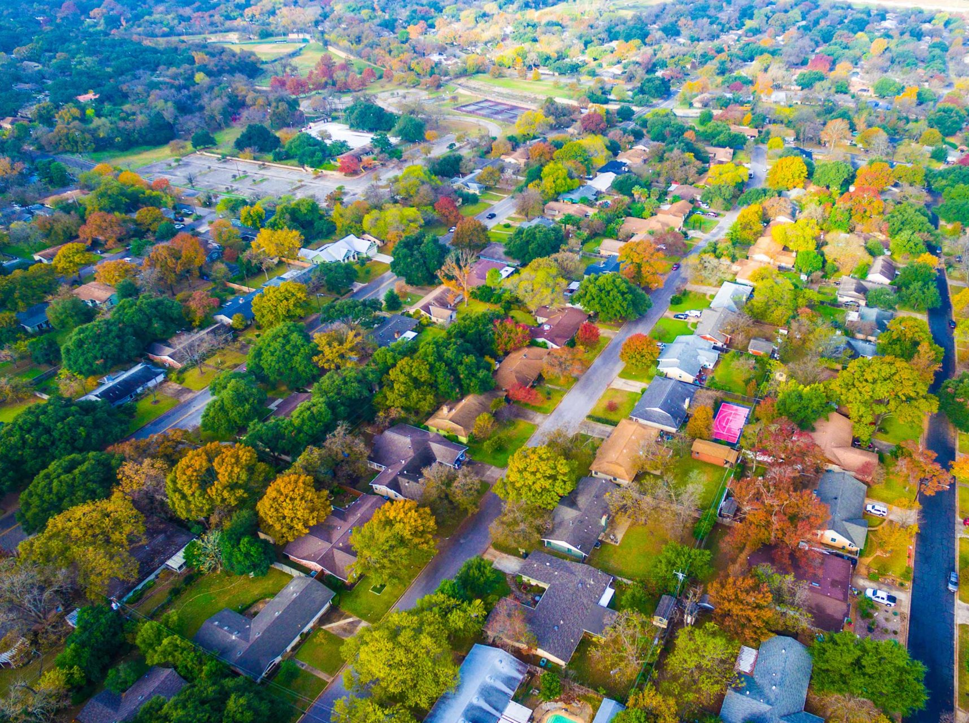
Municipal Land Use Law
C.40:55D-53 - NEW DEVELOPER
GUARANTEE REQUIREMENTS
September 2018
232 Kings Highway East
Haddonfield, NEW JERSEY 08033

Slide 2
C.40:55D-53
(1)(a) If required by ordinance, the developer shall furnish a performance guarantee in favor of the municipality in an amount not to exceed 120% of the cost of installation of only those improvements required by an approval or developer’s agreement, ordinance, or regulation to be dedicated to a public entity, and that have not yet been installed, which cost shall be determined by the municipal engineer, according to the method of calculation set forth in section 15 of P.L.1991, c.256 (C.40:55D-53.4), for the following improvements as shown on the approved plans or plat: streets, pavement, gutters, curbs, sidewalks, street lighting, street trees, surveyor's monuments, as shown on the final map and required by "the map filing law," P.L.1960, c.141 (C.46:23-9.9 et seq.; repealed by section 2 of P.L.2011, c.217) or N.J.S.46:26B-1 through N.J.S.46:26B-8, water mains, sanitary sewers, community septic systems, drainage structures, public improvements of open space, and any grading necessitated by the preceding improvements.

Slide 3
C.40:55D-53
(b) A municipality may also require a performance guarantee to include, within an approved phase or section of a development privately-owned perimeter buffer landscaping, as required by local ordinance or imposed as a condition of approval.

Slide 4
C.40:55D-53
(c) In the event that the developer shall seek a temporary certificate of occupancy for a development, unit, lot, building, or phase of development, as a condition of the issuance thereof, the developer shall, if required by an ordinance adopted by the municipality, furnish a separate guarantee, referred to herein as a “temporary certificate of occupancy guarantee,” in favor of the municipality in an amount equal to 120% of the cost of installation of only those improvements or items which remain to be completed or installed under the terms of the temporary certificate of occupancy.
At no time may a municipality hold more than one guarantee or bond of any type with respect to the same line item.

Slide 5
C.40:55D-53
(d) A developer shall, if required by an ordinance adopted by the municipality, furnish to the municipality a “safety and stabilization guarantee,”
solely for the purpose of returning property that has been disturbed to a safe and stable condition or otherwise implementing measures to protect the public from access to an unsafe or unstable condition, only in the circumstance that:
(i) site disturbance has commenced and, thereafter, all work on the development has ceased for a period of at least 60 consecutive days
(ii) work has not recommenced within 30 days following the provision of written notice by the municipality to the developer of the municipality’s intent to claim payment under the guarantee. A municipality shall not provide notice of its intent to claim payment under a “safety and stabilization guarantee” until a period of at least 60 days has elapsed during which all work on the development has ceased for reasons other than force majeure

Slide 6
C.40:55D-53
(2)(a) If required by ordinance, the developer shall post with the municipality, prior to the release of a performance guarantee; a maintenance guarantee in an amount not to exceed 15% of the cost of the installation of the improvements which are being released.
(2)(b) If required, a maintenance guarantee in an amount not to exceed 15% of the cost of the installation of the following private site improvements: stormwater management basins, in- flow and water quality structures within the basins, and the out-flow pipes and structures of the stormwater management system.

Slide 7
C.40:55D-53
(3)(e) The “safety and stabilization guarantee” shall be reduced by the same percentage as the performance guarantee is being reduced at the time of each performance guarantee reduction.
If the sum of the approved bonded improvements would exceed 70 percent of the total amount of the performance guarantee, then the municipality may retain 30 percent of the amount of the total performance guarantee and “safety and stabilization guarantee” to ensure completion and acceptability of bonded improvements, as provided above, except that any amount of the performance guarantee attributable to bonded improvements for which a “temporary certificate of occupancy guarantee” has been posted shall be released from the performance guarantee even if such release would reduce the amount held by the municipality below 30 percent.

Slide 8
C.40:55D-53
In the event that the obligor has made a cash deposit with the municipality or approving authority as part of the performance guarantee, then any partial reduction granted in the performance guarantee pursuant to this subsection shall be applied to the cash deposit in the same proportion as the original cash deposit bears to the full amount of the performance guarantee, provided that if the developer has furnished a “safety and stabilization guarantee,” the municipality may retain cash equal to the amount of the remaining “safety and stabilization guarantee.”

Slide 9
C.40:55D-53
The municipality may require the developer to post the inspection fees in escrow in an amount:
not to exceed, except for extraordinary circumstances, the greater of $500 or 5% of the cost of bonded improvements that are subject to a performance guarantee under subparagraph (a), subparagraph (b), or both subparagraph (a) and subparagraph (b) of paragraph (1) of subsection a. of this section; and
not to exceed 5% of the cost of private site improvements that are not subject to a performance guarantee under subparagraph (a) of paragraph (1) of subsection a. of this section, which cost shall be determined pursuant to section 15 of P.L.1991, c.256 (C.40:55D- 53.4).

Slide 10
C.40:55D-53
If the municipality determines that the amount in escrow for the payment of inspection fees, as calculated pursuant to subparagraphs (a) and (b) of paragraph (1) of this subsection, is insufficient to cover the cost of additional required inspections, the municipality may require the developer to deposit additional funds in escrow provided that the municipality delivers to the developer a written inspection escrow deposit request, signed by the municipal engineer, which: informs the developer of the need for additional inspections, details the items or undertakings that require inspection, estimates the time required for those inspections, and estimates the cost of performing those inspections.

Slide 11
Questions?
Contact John Cantwell, PE, PP, CME, Senior Associate
856-216-1890
John.Cantwell@rve.com

