Slide 1
New Jersey Infrastructure Bank
Innovation Council
April 3, 2018

Slide 2
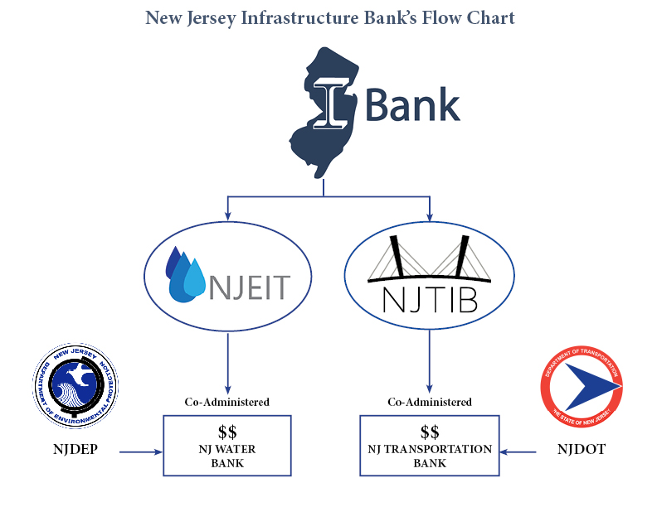
I Bank / DOT – NJ Transportation Bank
Mission - Provide and Administer low interest rate loans to qualified borrowers (counties, regional authorities, municipalities, and water purveyors) in New Jersey for the purpose of financing water quality and local transportation infrastructure projects.

Slide 3
I Bank / DOT – NJ Transportation Bank
Local Transportation Projects –
Borrower Eligibility Requirement
Must be a Local Government Unit:
County
Municipality
Municipal, county or regional Transportation Authority, or
Any other Political Subdivision of the State…
Authorized to construct, operate, and maintain public highways or “Transportation Projects” as defined pursuant to the Act (P.L. 2016, c.56)

Slide 4
I Bank / DOT – NJ Transportation Bank
Local Transportation Projects –
Project Eligibility Requirement –
Must meet definition of Transportation Project in (P.L. 2016, c.56) such as:
Public highways (defined),
Bridges,
Approach roadways and other necessary land-side improvements,
Ramps and Grade crossings,
Signal systems,
Roadbeds,
Transit lanes or Rights of Way,
Pedestrian walkways and Bridges connecting to passenger stations and servicing facilities,
Must be identified on DOT’s "Project Priority List” for the Legislature

Slide 5
I Bank / DOT – NJ Transportation Bank
Project Approval Processes –
Technical Process
Program staff (DOT / consulting Engineer reviews design for compliance)
Legal Process
I-Bank Staff and Program Bond Counsel work w/ Sponsor and Counsel to ensure satisfaction of Public Finance Law requirements (well versed thru NJEIT)
Credit Process
Project Sponsor must provide guarantee to the I-Bank (secures repay obligation)
Bond must be backed by a General Obligation tax pledge (G.O.) from the LGU or a sponsoring LGU being served by the project sponsor to collateralize the loan
G.O. must be Investmt-grade Rated – (limited exceptions-e.g. private rating, QBA)

Slide 6
I Bank / DOT – NJ Transportation Bank
Financial Components –
Borrowing Process – in development…
Applications will be submitted – Rolling = TBD
Application Forms – Electronic application similar to NJEIT H2LOans = TBD
Short-Term Construction Loan (currently up to 3 full State fiscal years)
funds Engineering, Planning & Design costs (architects, bond counsel, etc.)
funds construction costs through to completion (take out w/ L-T loan)
(like a Line-of-Credit; interest charged only on funds drawn for req’s)
Invoices required (cost-incurrence Program / not reimbursement)

Slide 7
I Bank / DOT – NJ Transportation Bank
Financial Components – Bonding Program
Conversion to Long-Term Loans (in development)
Savings (Est.) from receiving 49% of funds at 0% for 35 yrs = at least 26-30%
(lower rated LGUs save more)
Long-Term Funding Structure (State funds + Bonds)
S.T.I.B.
-------
$22.6M/ annum
Program Admin Costs [$1.6M]
S-T
Const
Loans
$21.0M
Loan Funds [$19M]
$19M State Loan Funds at 0% rate
Bond Reserves (for AAA) [$2.0M]
$20M Bond Funds at AAA% rate
Assumes 10:1 Leverage

Slide 8
Questions
David Zimmer
Executive Director dzimmer@njib.gov
609-219-8604

