Slide 1
Hydrologic & Hydraulic Reviews for NJDOT Access, Drainage and Operations Permits April 5, 2017
Sandra Blick / Meeta Trivedi
Hydrology & Hydraulic Unit – NJDOT BLAES

Slide 2
Major Access Permits & Operations Permits
Typically required when….
entering DOT ROW, updating land use of the property, lot line is updated or discharging to NJDOT System
Permit group distributes projects to NJDOT SMEs (Subject Matter Experts) for review and approval based on discipline (e.g., Traffic, Roadway Geometry, Pavement, Utilities, Drainage)
Drainage portion reviewed by Hydrology & Hydraulics Unit
Notes:
Oue H&H unit reviews permit applications for Major Access and Operations Permits unit at NJDOT. Typical process for handling projects by these two units is, when there are more than 500 trips per day from a driveway on the state road, application is handled by Major Access unit. In cases where trips per day are less than 500, it is handled by Operations Permits unit, which is also called Minor Access application.
These permits basically required when the proposed project is entering into DOT ROW or when the developer is updating the land use conditions of the property. When lot line is being updated or there is a proposed discharge to the state drainage system – this permits are required.
When applications are submitted to major access unit or operations permits unit, they distribute relevant plans and reports to subject matter experts (SMEs) of respective units – such as traffic, pavement, geometric design, utilities or H&H unit. Major access unit and operations permits unit distributes these applications to other units within DOT based on the uniqueness of the project. Each SWM and drainage related applications are sent to our unit for review.

Slide 3
Stormwater Standards for Project Reviews that Impact DOT Drainage or Roadways
Access Checklist
NJDEP SWM rules and NJDOT Water quantity impacts at each point of discharge
New curbing on the state road which was umbrella section in existing condition, triggers water quality in proposed condition
Notes:
Here are the basic stormwater standards we look for whether considered while reviewing applications:
Access Checklist: I have here a copy of the drainage permit checklist which is required to be submitted with all the applications seeking approval from our unit. We do not find copy of this filled checklist with majority of the applications. Please note that it is required to submit with initial submission. We are in the process of updating this drainage checklist – which will be updated in NJDOT drainage design manual in near future.
SWM Rules and NJDOT water quantity discharge:
Please know that stormwater management requirements by NJDEP and NJDOT are different for meeting water quantity regulations. DEP follows standards from NJAC 7:8 – 5.4 where it talks about criteria (i) pre and post construction runoff hydrographs to not exceed at any point in time, (ii) demonstrate that there is no increase in pre and post conditions runoff rates and demonstrate no flood damage at the site or in downstream of the site (iii) post runoff rates are reduced to 50, 75 and 80% than existing conditions.
NJDOT criteria for meeting water quantity requirement is listed in point 9 in Access checklist. It talks about no increase in drainage flow rate in proposed conditions permitted for 2, 10, 25 and 100 year storms.
Water quality treatment for proposed curbing: in conditions where roadway umbrella section is removed and curbing is added, note that this area will be new added impervious area. Water quality treatment is required even if this is not 0.25 acres of impervious area.

Slide 4
Typical H&H Issues on Access Permits
Project description – total area of disturbance and net increase in impervious surface
Points of Interest
New discharge to DOT system (changing existing drainage pattern)
Projects where gas station is proposed, petroleum pollutants treatment is required
Notes:
Here is the list of items we look for while reviewing permit applications.
Project description and area of disturbance give us big picture of the project – major development, new impervious added, etc.
We will be reviewing next two topics – Point of Interest impact to DOT system and new discharge to DOT system, eg. Changing existing drainage pattern.
When there is a proposed gas station, we ask for treating the petroleum pollutants prior to it enters into DOT system.

Slide 5
Typical H&H Issues on Access Permits
Existing and proposed conditions drainage area maps
Infiltration Basin Designs
Soil Testing results
Maintenance plan for BMPs
Are NJDEP or other permits required?
Notes:
In most cases existing and proposed conditions drainage area maps are submitted to us with the application. However, in cases where hydrologic model is submitted with the report, if drainage area labels match with the drainage area labels provided in the map – it is easier for our review. We have majority of programs installed on our machines, so we ask for submitting an executable files with the submission. It makes review process quicker.
Once the project is ready for approval, we ask to submit us digital copy of the final report, calculations and plans sealed and signed by the professional engineer for easier storage.
While reviewing infiltration basin design, we check whether infiltration rate is considered as zero while performing routing calculations.
It is required that soil tests are conducted considering Appendix E – soil testing criteria of BMP manual. Chapter 8 of the BMP manual discusses in detail about maintenance plans and schedules for BMP structures. Sandy will talk in detail about these topics.

Slide 6
H&H Issues: Points of Interest
Impact on NJDOT drainage system, roadways, and discharges
POI often combined on general direction of drainage
POI does not address impact to Drainage System
Notes:
As discussed earlier, here is the major issue we notice in our review – impact on NJDOT drainage system, on state roadways and discharges at each point of interest in existing and proposed conditions.
POI is often combined as one Point of interest rather than two. Also in such situations, we look for analysis to state’s drainage system.

Slide 7
POI: Existing Conditions
Notes:
Here in the sketch we see that DA – A is flowing to POI 1 and DA – B is flowing to POI 2. so there are two point of discharges.

Slide 8
POI: Proposed Conditions
Peak Evaluation based on site
Peak Reduction must be met for site AND
Maintain or reduce quantities at POI 1 for drainage capacity OR
Evaluate drainage system capacity from POI 1 to POI 2
P
r
r
oposed D
ainage
A
r
ea
POI 2
POI 1
Notes:
In proposed condition, entire site is directed to POI 1. in such situations peak reduction rate for the site must be met at discharge point. It is compared here from DA-A in existing condition to entire site in proposed condition. So proposed design must meet the peak discharge requirement in such case.
Also it is required to evaluated drainage pipe and inlet capacity for downstream of the POI 1.

Slide 9
Issues: New Discharge to NJDOT System
Existing drainage patterns to be maintained
New discharges must be shown to be necessary
Notes:
Here is the example where existing drainage pattern is changed.
In Existing condition, entire site is flowing towards the stream and then passing through the culvert.

Slide 10
New Discharge to NJDOT
Additional permits not justification for new discharge
Allowed in very limited circumstances
Notes:
In proposed condition, a small portion is flowing towards the stream while rest of the site is diverted to the state inlet via proposed basin. In normal circumstances we do not approve this design.
If developer needs to take permit from DEP for creating an outfall at the stream, they are required to do so.
There are very limited circumstance when such permits are approved, such as if stream is a category 1 water

Slide 11
Water Quantity
SWM Rules: Comply with reduction requirements
NJDOT Criteria: No increase in drainage flow rate (2, 10, 25 and 100)
Impacts need to be addressed at each point of discharge
Pipe connecting to NJDOT drainage system must match with the roadway design frequency
10 or 15-year, depending on roadway
Inlets spread and pipe capacity analysis is required
Infiltration rate must be considered zero for infiltration basin

Slide 12
Water Quality & GW Recharge
Treatment for petroleum pollutants
If roadway umbrella section is converted to roadway curbing, additional impervious area need to be addressed for water quality
Maintain 100% of existing groundwater recharge or infiltrate increase in 2-year volume

Slide 13
Typical H&H Issues on Access Permits
Infiltration Basin Designs
Soil Testing results
Maintenance plan for BMPs
Notes:
asdfsdf

Slide 14
H&H Issues: Infiltrating Basins
Basins where infiltration criteria is missed
Underground Basins
Combined Infiltration/Detention Basins
Infiltration Basins for projects exempt from SWM rules
Infiltration basins with overflows to DOT in the event of failure
DOT has criteria for discharges to DOT system beyond NJAC 7:8

Slide 15
Infiltration Issues
Infiltration/exfiltration used for peak reduction analysis
Infiltration contact with water from gasoline stations
Mounding analysis not performed to determine draindown time

Slide 16
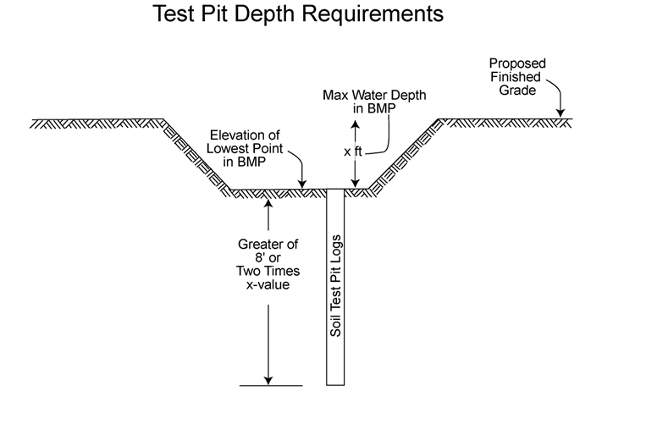
Infiltration Issues
Soil Profile Pit
Missing elevations
Missing SHWT
Not deep enough
Insufficient information to support mounding analysis
Permeability tests not acceptable

Slide 17
Groundwater Recharge
Not required in previously developed portions of PA-1
Areas in PA-1 with trees and shrubs still require GW recharge
Unknown Soil Types: Cut and Fill, Urban Lands, etc.
Assumed to be HSG “D” without soil testing

Slide 18
Infiltration Issues: Groundwater Mounding

Slide 19
Groundwater Mounding: USGS
Proposed infiltration depth is product of recharge/infiltration rate and time
R & t can be revised to determine if it will drain in 72 hours. Remaining values should not be changed.

Slide 20
Other Issues
Other agency SWM approvals
No automatic NJDOT approval and vice versa
NJDOT has other criteria
Minimal review of projects which do not impact NJDOT system
Privately owned pipes in NJDOT ROW – typically prohibited
Moving/changing existing channel near NJDOT roadway – cannot increase flooding regardless of Drainage Area

Slide 21
Other Issues
Assumed to be exempt from groundwater recharge requirement – not previously developed areas
Maintenance Plan – Does not meet NJAC 7:8-5.8 (Responsible parties, cost estimates)
Rational method used for basin routings (or no assessment of critical duration storm)

Slide 22
Other Issues
Construction of project commenced prior to DOT approval
Municipal decision - Property not owned by NJDOT
NJDOT review not based on construction which took place
Has caused issues where approval could not be obtained to tie into NJDOT
Approved plans based on permeability rate/SWHT unable to be achieved during construction
Call us as soon as you know about the issue

Slide 23
Contact Information - NJDOT H&H Unit
General Number: (609) 530-5673
Sandy Blick: Sandra.Blick@dot.nj.gov : (609) 530-2283
Meeta Trivedi: Meeta.Trivedi@njdot.nj.gov : (609) 530-5363

