Slide 1
NJDEP Stormwater Program-Update
Presented by:
Jim Murphy, Chief
Bureau of Nonpoint Pollution Control
NJSME General Membership Meeting
February 8, 2017

Slide 2
Stormwater Program Update
MS4 Permit Audit
MS4 Permit Revisions
Non- Structural Stormwater Management Rule Change
Best Management Practice Manuals
Stormwater Maintenance Guidance
MTD Certification Process
Stormwater Training
CSO Permit
TMDL Look-Up Tool
Green Infrastructure
5G3 Permit

Slide 3
MS4 Permit Audit Program
MS4 Permit Audit
Audits Commenced 2016
Trial Audits completed 2015
Audit Process (Schedule Date of Audit; Request for Documents; Pre-Audit Preparation; On-Site Interview)
Audit Selection Process (Annual Reports/Supplemental Questionnaires; Enforcement Consulted; Construction Permits; Impaired Waterbodies)

Slide 4
Goals of the MS4 Audit Program
MS4 Permit Audit
Permit Compliance
Compliance Assistance
Effectiveness of the Permit
Permit Modifications
Rule Changes
BMPs
Guidance
Education
Outreach
Training

Slide 5
MS4 Audit Selection
MS4 Permit Audit
Advance Notice and Coordination
Minimum 30 days notice
www.nj.gov/dep/dwq/tier_a_guidance_other.htm
On-site Discussion and Review
1 or 2 Days
Stormwater Coordinator/Twp Engineer, etc.
Areas of Focus
MS4 Permit Conditions-SBRs, Ordinances, etc.
Post Construction Requirements under NJAC 7:8

Slide 6
MS4 Audit Report
MS4 Permit Audit
Audit Report Issuance by NJDEP
Areas of Concern
Improvement to Key Areas
Areas of Merit

Slide 7
Audit Findings to Date
MS4 Permit Audit
SBRs
Post-Construction
Local Public Education
Employee Training
Other Permit Conditions
SPPP Not Updated
Outfall Pipe Mapping
Annual Reports
Illicit Connection Elimination

Slide 8
Renewal MS4 Permit
MS4 Permit Revisions
Preliminary Draft Permit
Draft Permit
Final Permit
February 2016
February 2017
Late-2017
Outreach
February-June 2016

Slide 9
New Permit vs. 2009 Tier A Permit
MS4 Permit Revisions
New Stormwater Facility Inventory & Mapping
Stormwater Basins, Subsurface Retention/Detention Systems, MTDs, GI, and Outfalls
Maintenance Requirements
Post-Construction Stormwater Review
Clarified Conditions Related to Municipal Oversight of Certain Private Stormwater Facilities
Checklists for newly proposed stormwater management measures
GIS Coordinates
Planning with Awareness of Known Impairments and other Impacts
Clarified Municipal Maintenance Yard Module
Clarified that Post-Construction Stormwater Rules Apply in All Areas
Required Training for Board Members and Those Involved in Review of Stormwater Design
Supports Effective Maintenance

Slide 10
New Permit vs. 2009 Tier A Permit
MS4 Permit Revisions
New Stormwater Facility Inventory & Mapping
Stormwater Basins, Subsurface Retention/Detention Systems, MTDs, GI, and Outfalls
Maintenance Requirements
Post-Construction Stormwater Review
Clarified Conditions Related to Municipal Oversight of Certain Private Stormwater Facilities
Checklists for newly proposed stormwater management measures
GIS Coordinates
Planning with Awareness of Known Impairments and other Impacts
Clarified Municipal Maintenance Yard Module
Clarified that Post-Construction Stormwater Rules Apply in All Areas
Required Training for Board Members and Those Involved in Review of Stormwater Design
Supports Effective Maintenance

Slide 11
New Permit vs. 2009 Tier A Permit
MS4 Permit Revisions
“Map As You Inspect”
Inspection and Maintenance of Stormwater Facilities
Maintenance Requirements
Post-Construction Stormwater Review
Clarified Conditions Related to Municipal Oversight of Certain Private Stormwater Facilities
Checklists for newly proposed stormwater management measures
Maintain a Log
Planning with Awareness of Known Impairments and other Impacts
Clarified Municipal Maintenance Yard Module
Clarified that Post-Construction Stormwater Rules Apply in All Areas
Required Training for Board Members and Those Involved in Review of Stormwater Design
Locational information
Inspector
Date
Findings
Maintenance Performed

Slide 12
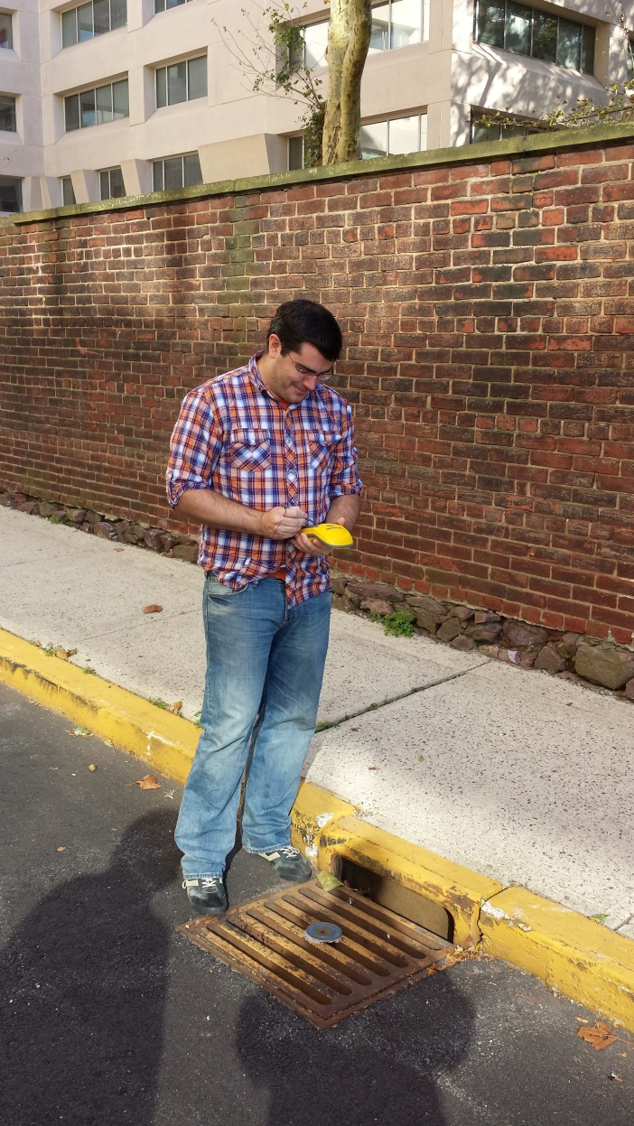
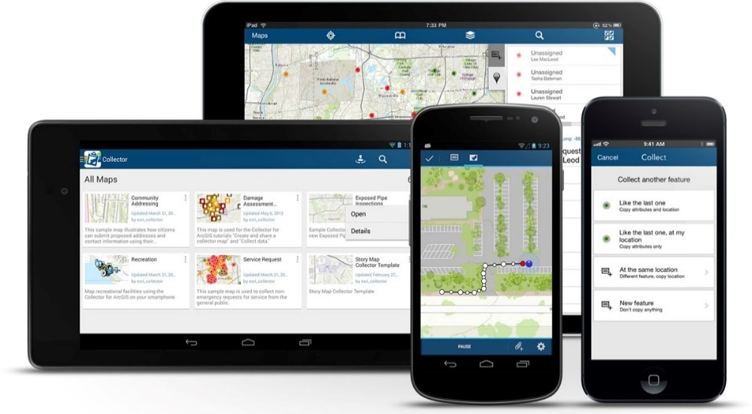
NJDEP Assistance – Location Information
MS4 Permit Revisions

Slide 13
Training Requirements in the Preliminary Draft Tier A
MS4 Permit Revisions
Municipal Employees
Within 3 Months of Commencement of Duties
Every Two Years Thereafter
Review for 7:8 Compliance (e.g. Twp Engineer)
Complete Department Training Relative to NJAC 7:8 once every Five (5)
Municipal Board and Governing Body Members
Within 6 months of EDP or Within 6 months of commencement
“Asking the Right Questions”
Once Per Term Thereafter

Slide 14
Training Requirements in the Preliminary Draft Tier A
MS4 Permit Revisions
Design Engineer, Municipal Engineer, etc.
Stormwater Management Design Review Course
Currently-Annual with coordination by/through Rutgers
Cost ~ $600
Complete Course within EDP +12 Months
NJDEP to Offer at least Twice Per Year
FREE!!
Complete Once Every Five Years
Review of Stormwater Development and Re-Development Projects on behalf of the Municipality

Slide 15
Nonstructural Strategies of Stormwater Management rules
Non- Structural Rule Change
Court Ruling
Nonstructural Stormwater Strategies Point System is not adopted through APA Rulemaking Process
NJDEP Work Group Meetings
Develop objective quantifiable standard
Stakeholder Meetings
Round 1
Round 2 March 2017
Not conflict with other requirements
Flexible enough to apply across State
October 2014 – Spring 2015

Slide 16
New / Updated BMP Chapters
Best Management Practice Manuals
Standard Constructed Wetlands
Sand Filters
Vegetative Filter Strips
Wet Ponds
Grass Swales
Subsurface Gravel Wetlands
Extended Detention Basins
Pervious Paving
Dry Well
Infil-tration Basin
Rain Garden
Cistern
MTDs
Blue Roof
Green Roofs
Biore-tention System
In Progress …
Notes:
Updated BMP Guidance Manual-Chapter 9
Finalize 7 draft BMPs
Ensure consistent format
“Fact Sheets” for each BMP
Make it more “User Friendly”
Focus Group Feedback

Slide 17
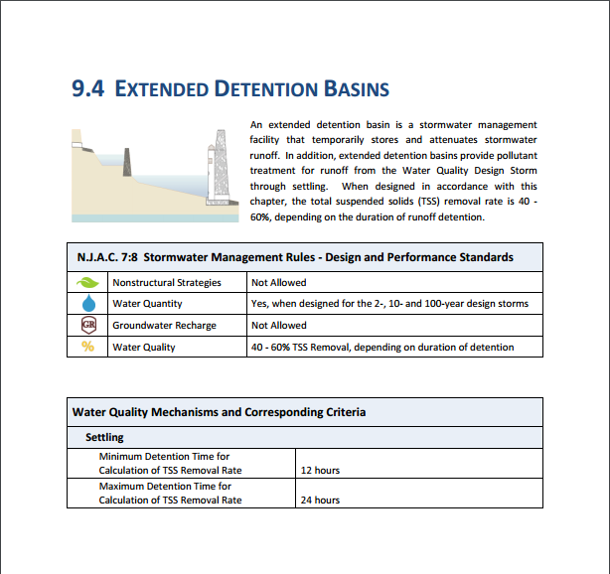
Best Management Practice Manuals

Slide 18
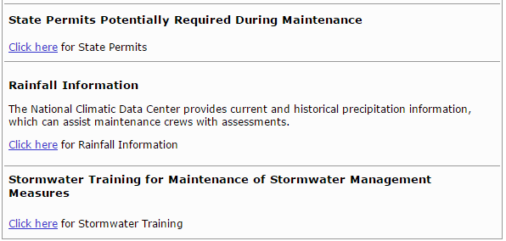
Stormwater Maintenance Guidance & Website
Stormwater Maintenance Guidance
Templates and Field Manuals
Maintenance Website
- Resources and Information

Slide 19
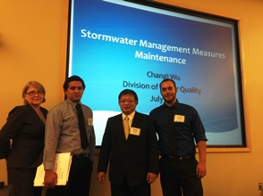
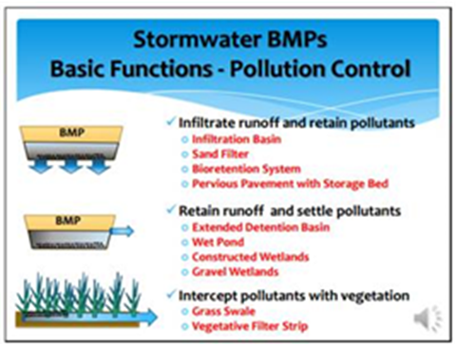
Stormwater Training
Stormwater Training
Live Training Courses
Videos & Interactive Tools
Training for NJDOT
New Training Page at DEP Website
www.njstormwater.org/training.htm

Slide 20
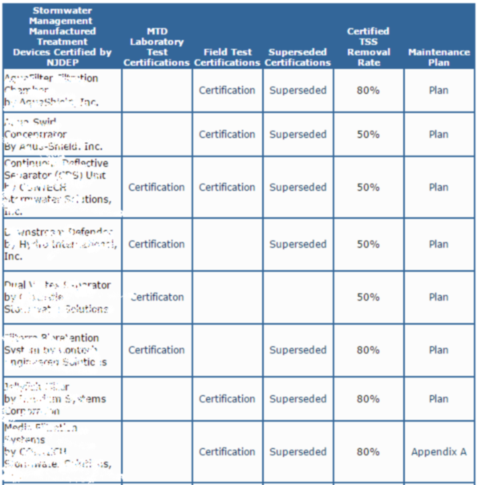
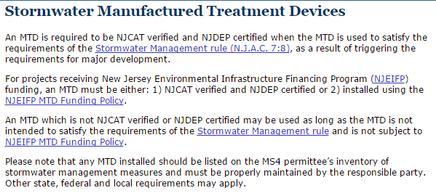
Manufactured Treatment Devices (MTD) Certification Process
MTD Certification Process
Certified MTD
NJDEP
NJCAT

Slide 21
5G3 General Permit
5G3 Permit
Construction Activity GP – NJ0088323
Expires February 28, 2017
Renewal Permit
Public Comment Period Closed 1/6/2017
Effective March 1, 2017
www.nj.gov/dep/dwq/5g3.htm
Minor Changes to the Permit

Slide 22
Combined Sewer Overflow
CSO Permit
Evaluation of Alternatives
DEP Multi-disciplinary Teams
Community Collaboration
CSO
25 Individual Permits
Issued March 2015
217 Outfalls
20 Municipalities
Outfall Reduction
281 to 217 Outfalls
20% Reduction
Solid and Floatables Controls
Near Every Outfall

Slide 23
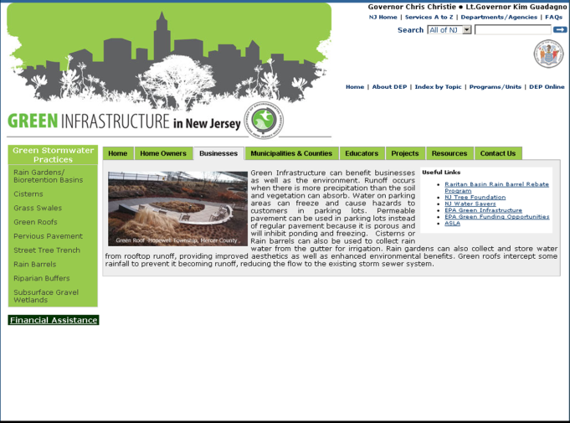
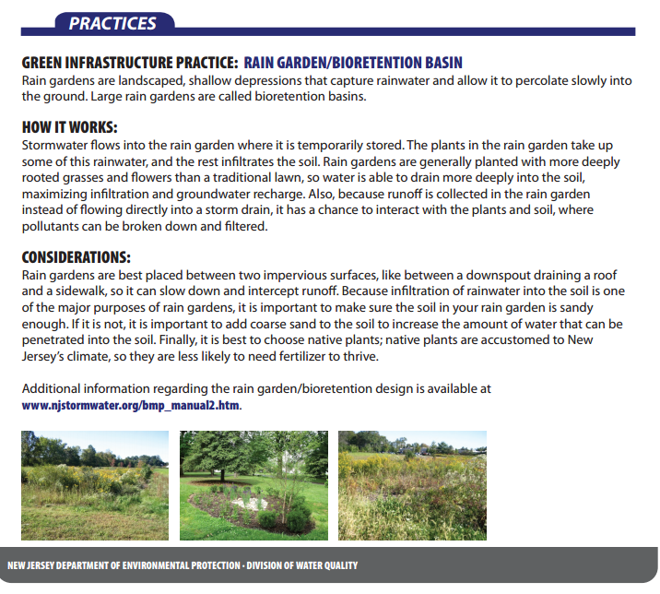
Green Infrastructure
Green Infra-structure
www.nj.gov/dep/gi/
Promote and Demonstrate Green Infrastructure Projects in NJ

Slide 24
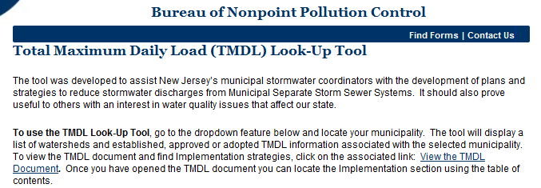
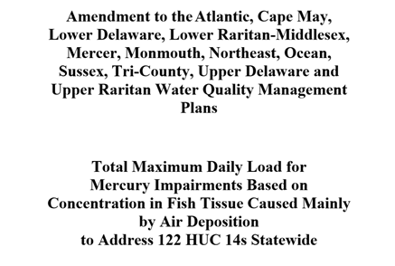
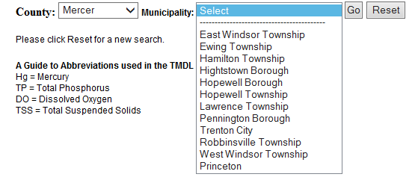
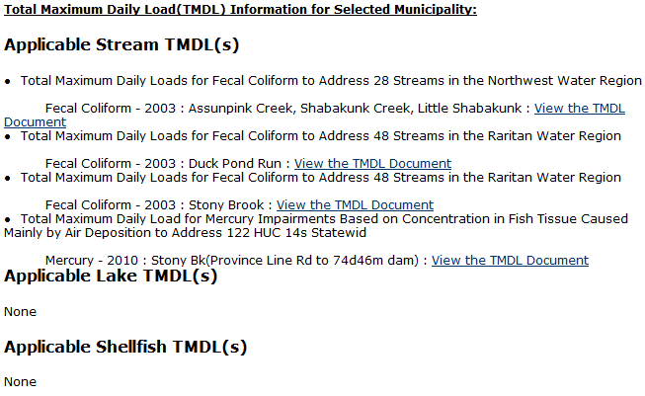
TMDL Look-Up Tool
TMDL Look-Up Tool
Posted at www.nj.gov/dep/dwq/msrp_home.htm

Slide 25
Stormwater Program Update
MS4 Permit Audit
MS4 Permit Revisions
Non- Structural Stormwater Management Rule Change
Best Management Practice Manuals
Stormwater Maintenance Guidance
MTD Certification Process
Stormwater Training
CSO Permit
TMDL Look-Up Tool
Green Infrastructure
5G3 Permit

Slide 26
Questions?
Jim Murphy, Chief
Bureau of Nonpoint Pollution Control
609-633-7021
James.murphy@dep.nj.gov

